Slide 1





Technology Assessment and Comparison of Contemporary Vehicles that run on different technologies
Last Name | First Name | Email
Darbha | Arjun | adarbha@mtu.edu
Mahamuni | Pratik | ppmahamu@mtu.edu
Menon | Sunit | ssmenon@mtu.edu
Xiong | Guangchen | gxiong@mtu.edu
Group Number 6
MEEM Department
Michigan Tech University

Slide 2
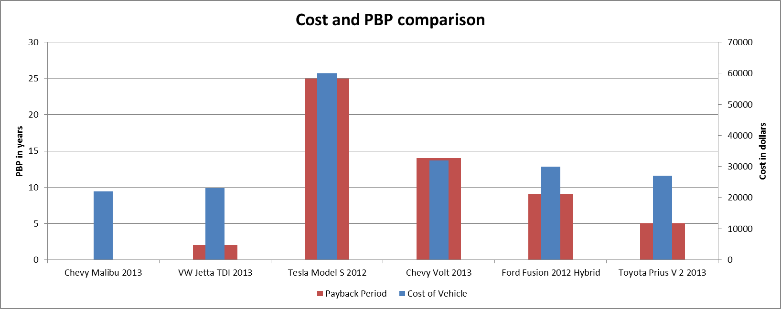

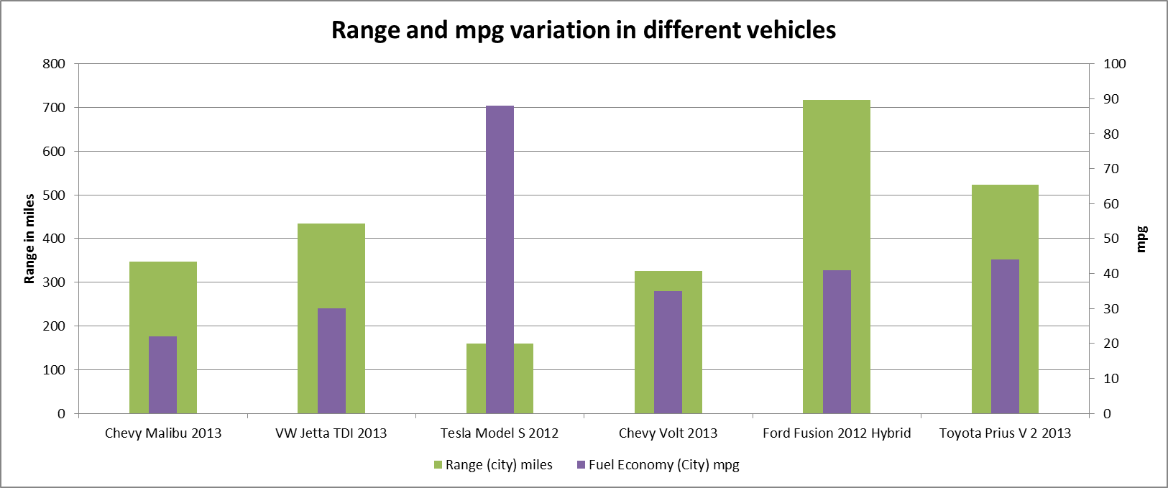

Slide 3

Summary and conclusions
From the comparisons of various parameters of different types of vehicles, the following conclusions can be drawn.
Electric vehicles and hybrid electric vehicles are the only future due to depletion of naturally occurring fossil fuels
High initial cost is the major drawback for the technology’s penetration into the market
Exhaustive research in this field in order to reduce the cost of technology would be an effective way to solve the problem

